Slide 2
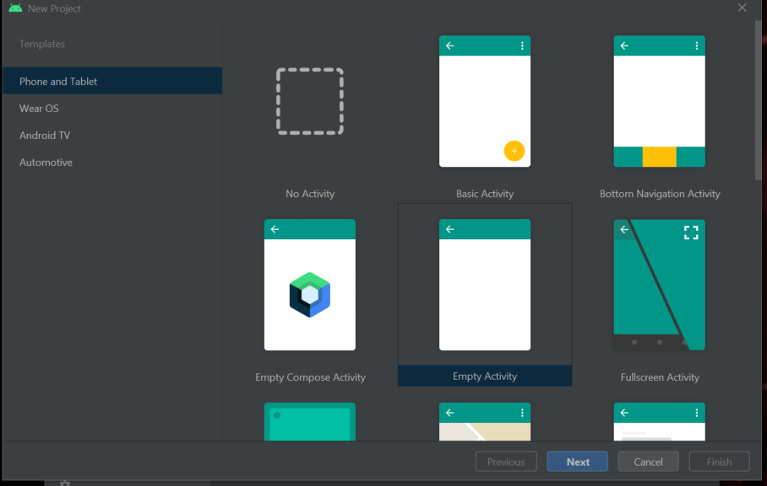
Click “New project”-> “Empty Activity”

Slide 3
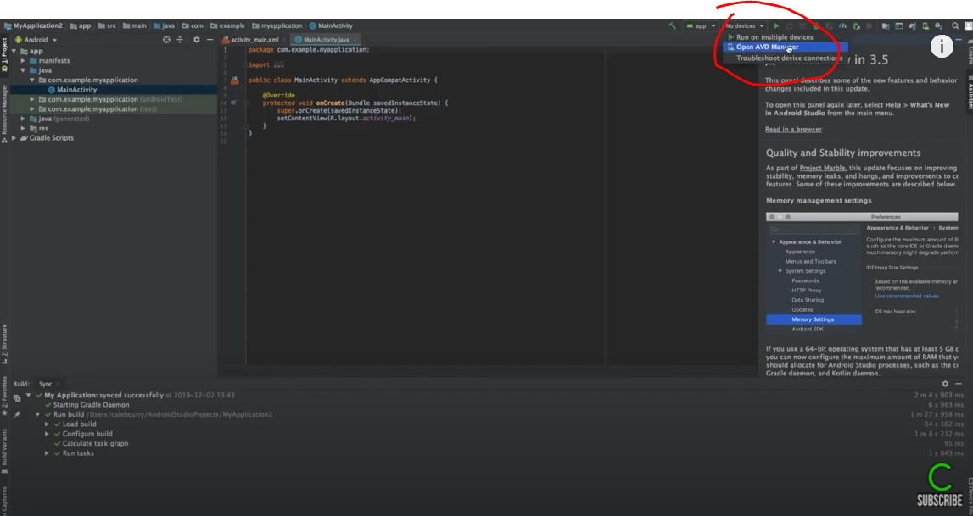
Click “No devices” -> “Open AVD Manager”

Slide 4
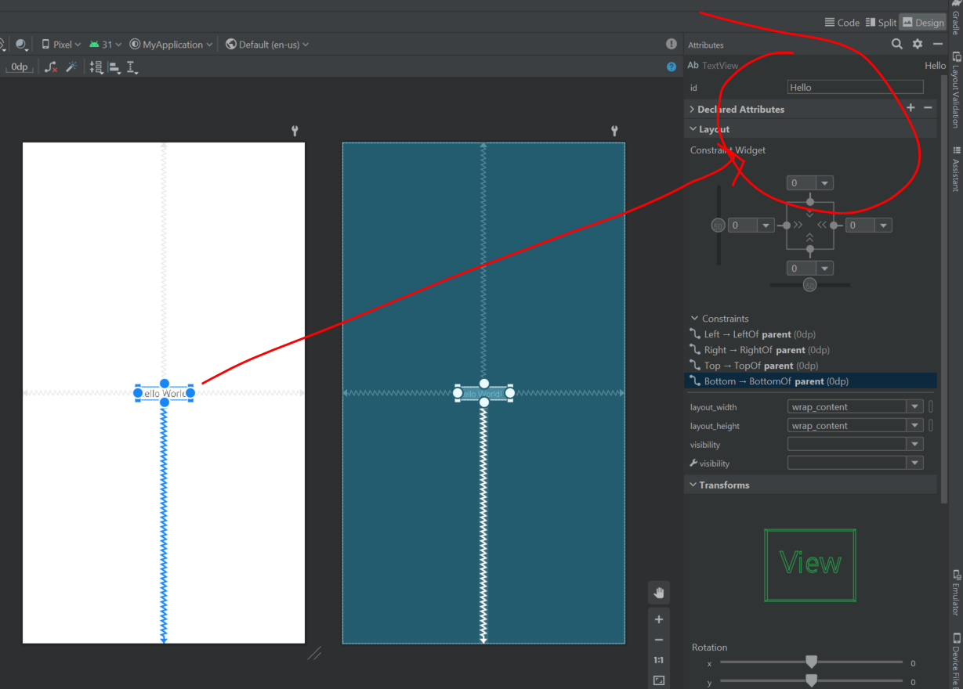
Give every object a meaningful name
E.g. “Hello”
So that we can refer to this name in our script

Slide 5
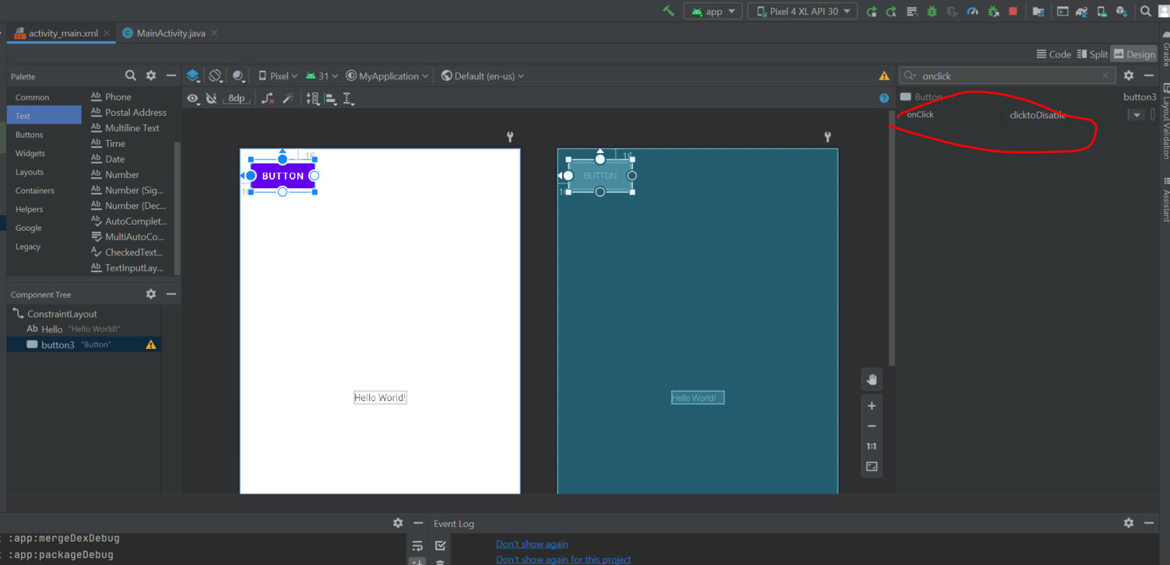
Disable button when click
1) Change the button “onClick” to a random name e.g. “clicktoDisable”

Slide 6
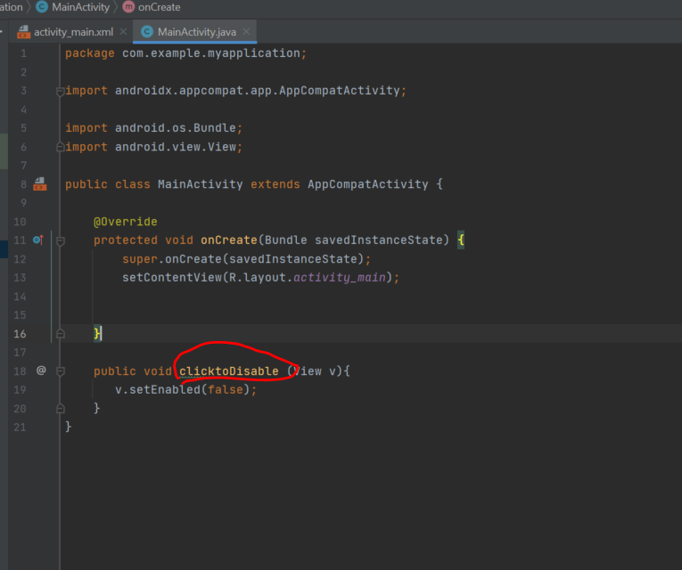
Cont’
Update code in java script:

Slide 7
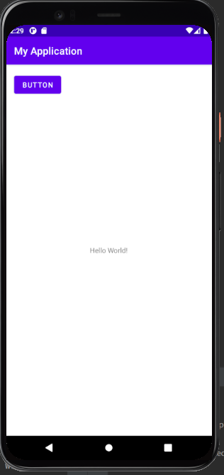
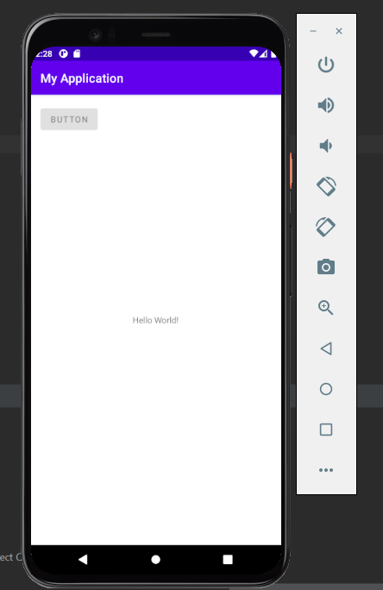
Results
click

Slide 8
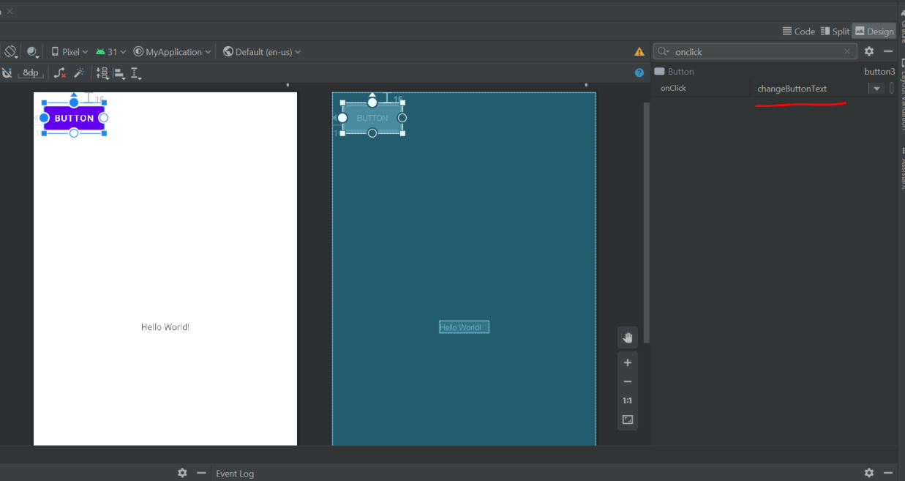
Change button textcontent upon click
Change button onclick to a meaningful name:

Slide 9
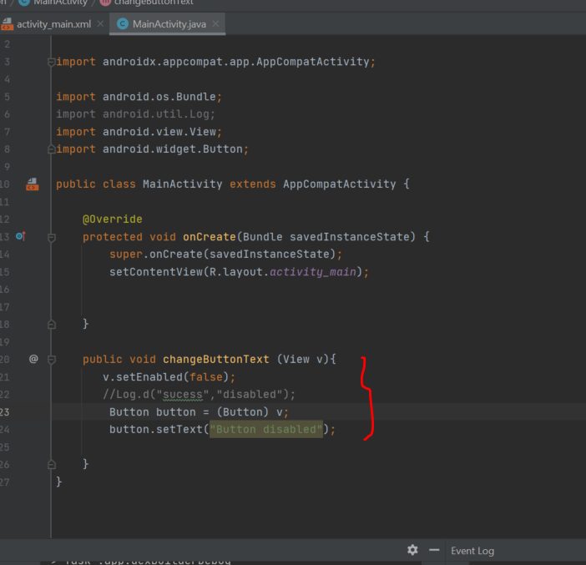
Update script

Slide 10
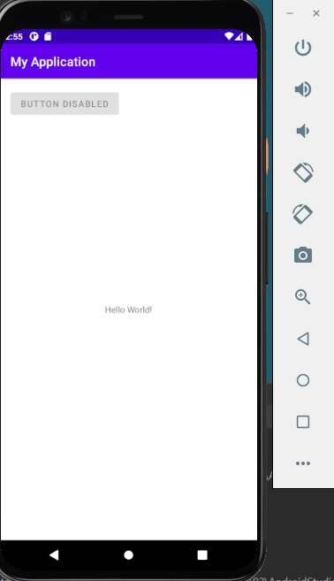
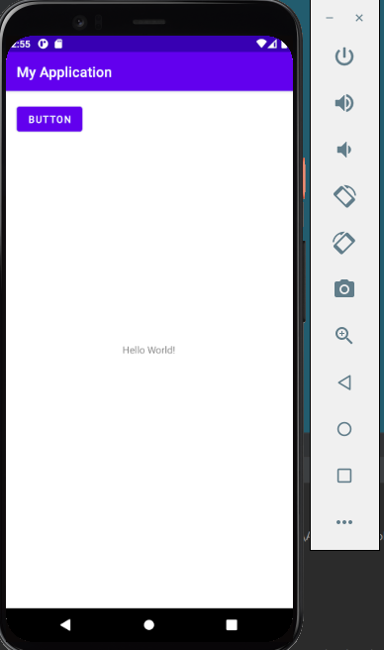
Result
click

Slide 11
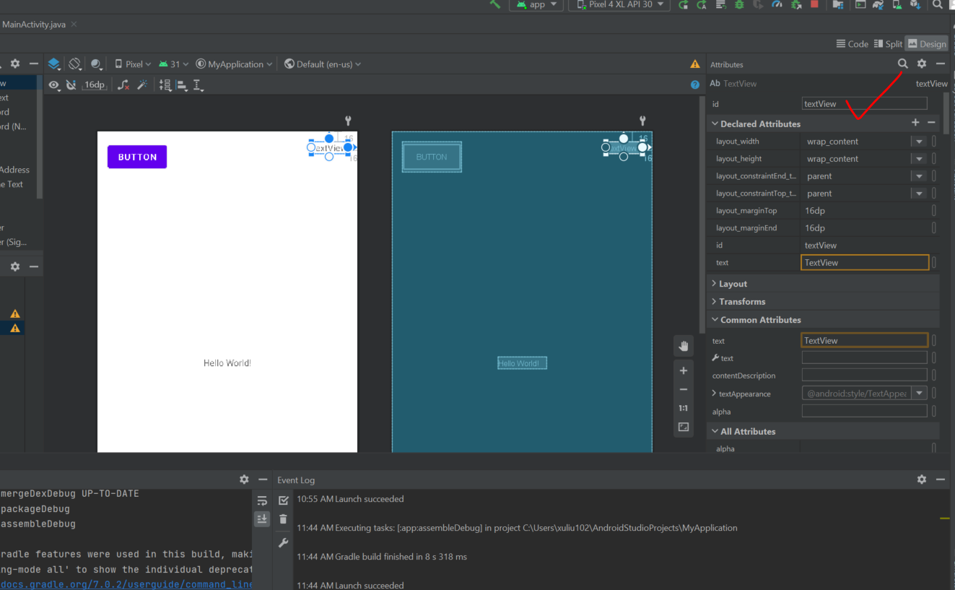
Click button to change text
Create a textview:

Slide 12
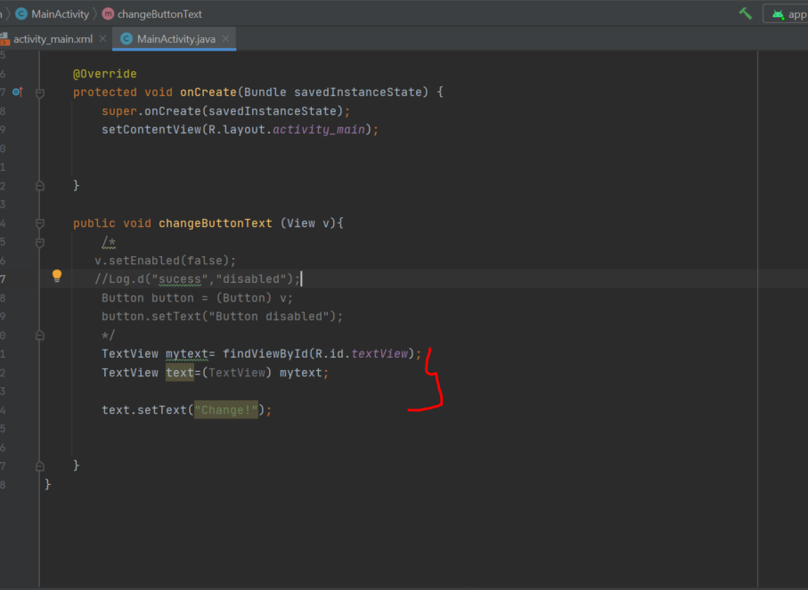
Update script
Textview which named “textview” will change to “change!” when click the button

Slide 13
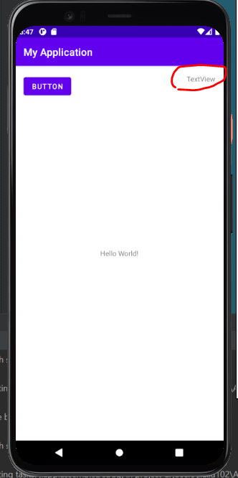
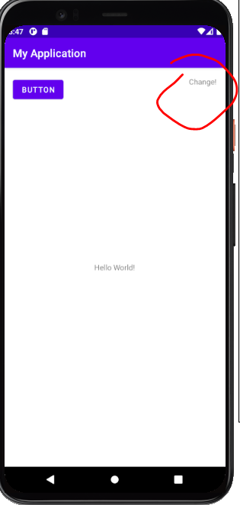
Results

Slide 14
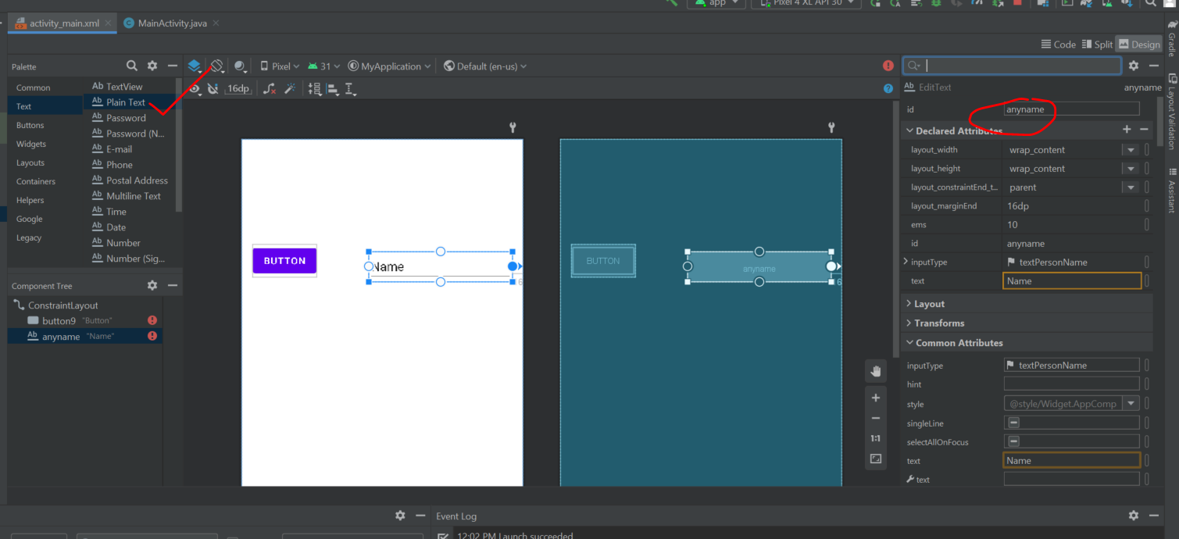
Create plain text and rename it

Slide 15
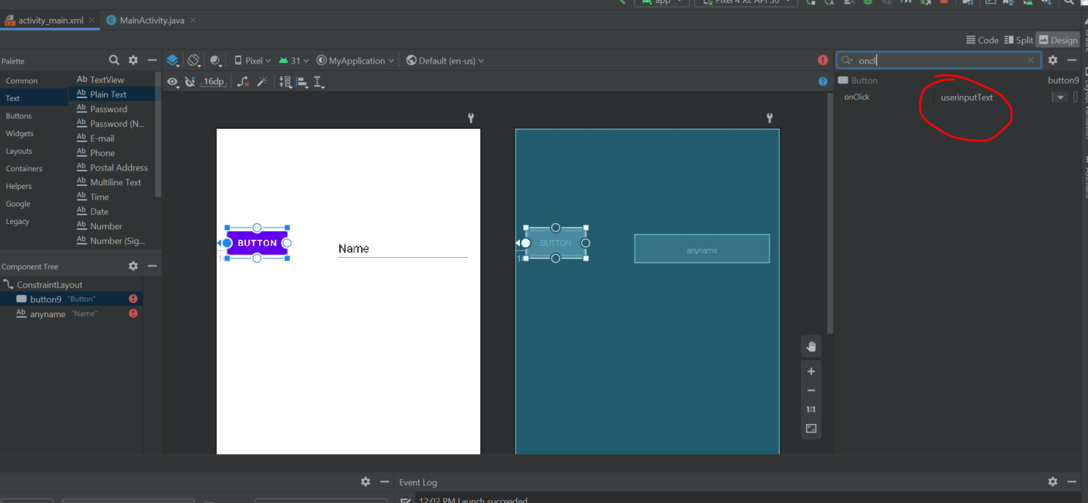
Create button and change the “onclick” name

Slide 16
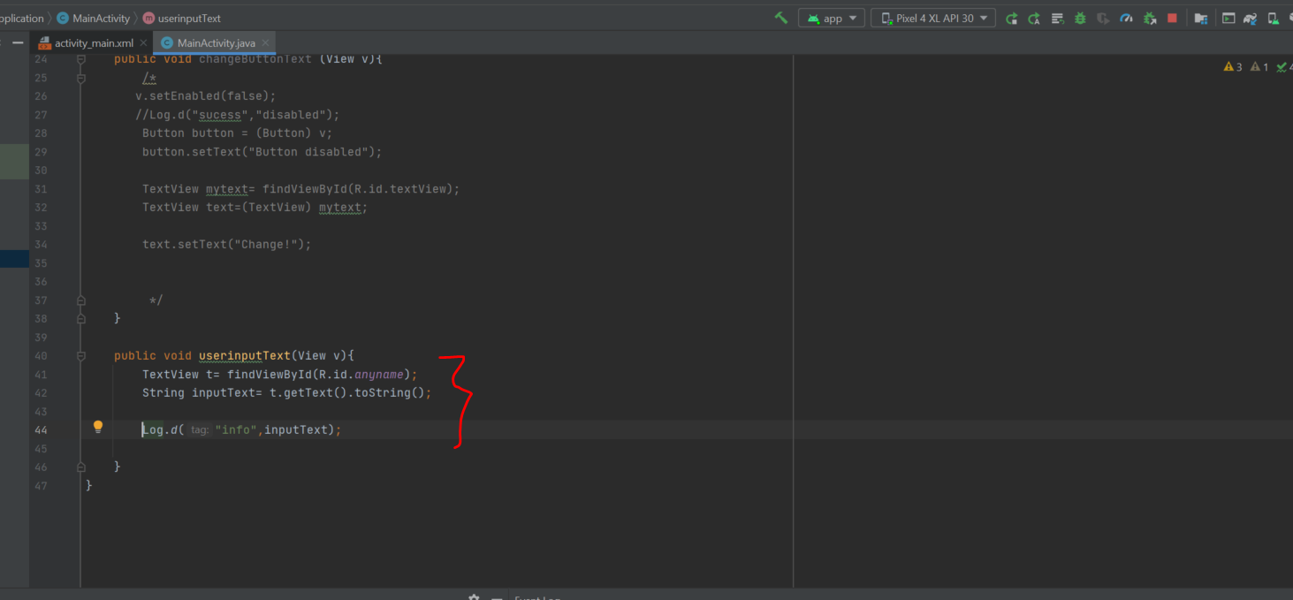
Update script
Button onclick name which set in the previous slide
Plain text name “anyname”

Slide 17
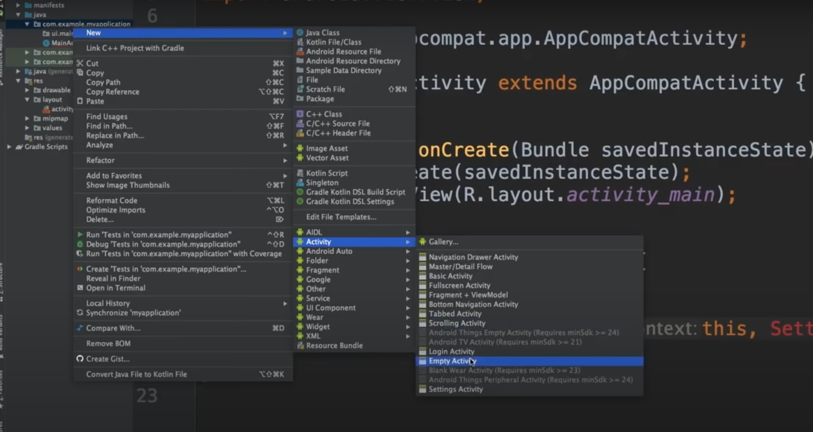
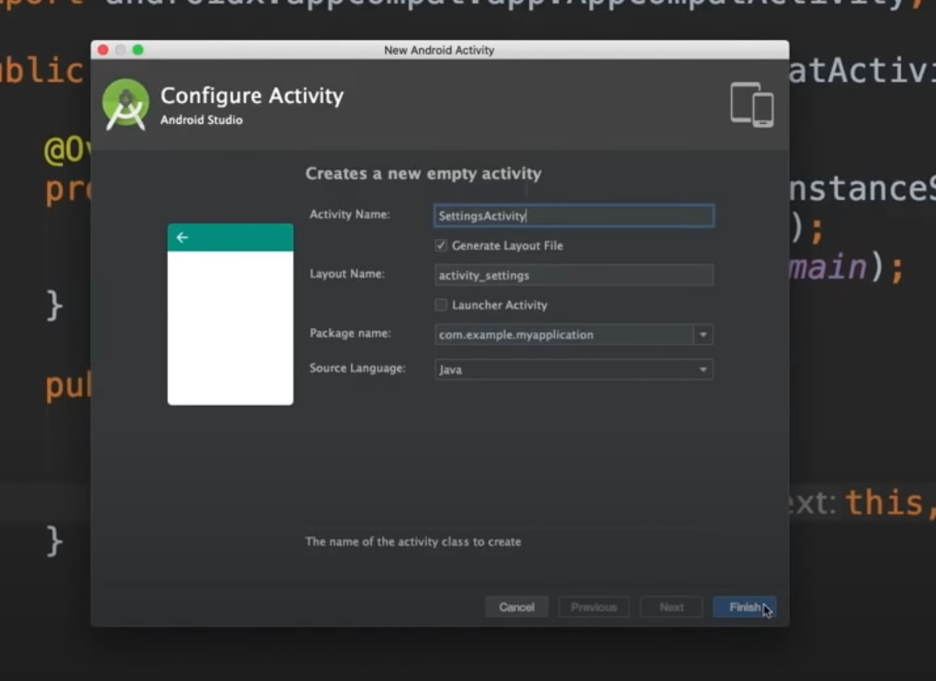
Create new activity

Slide 18
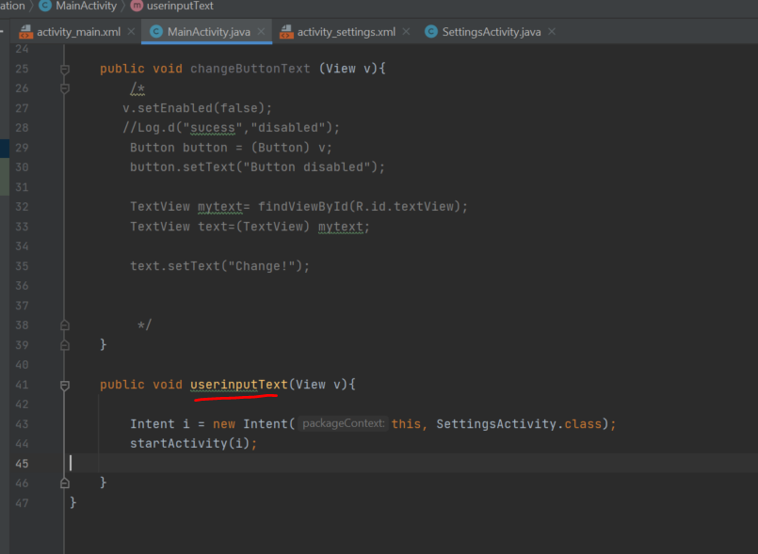
MainActivity.java

Slide 19
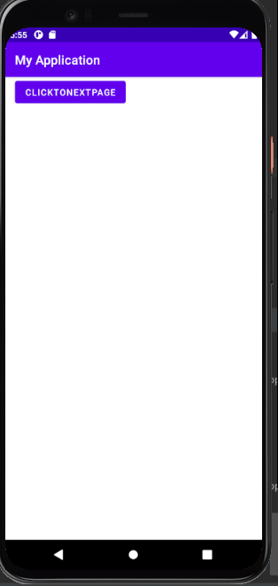
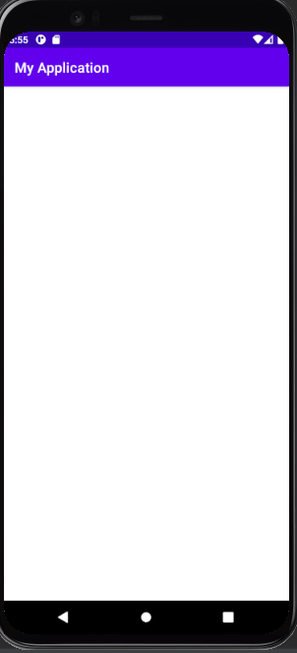
Results (click button jump to next page)
Click button

Slide 20
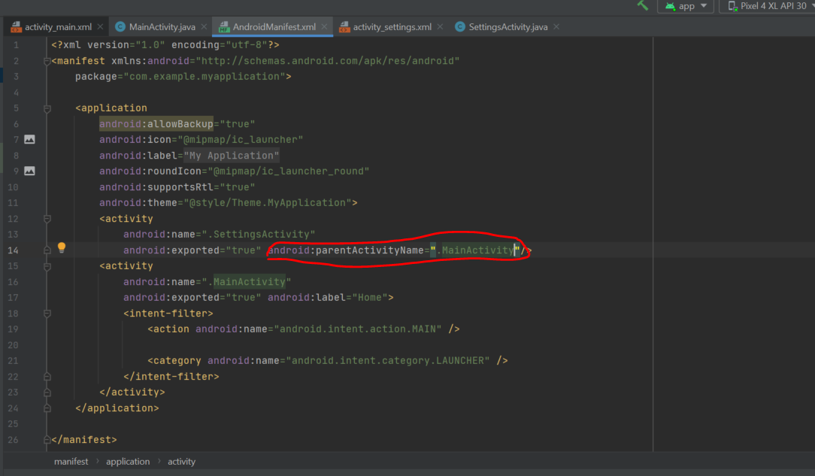
Child page to Parent (main) page
Edit in “AndroidMainfest.xml”

Slide 21
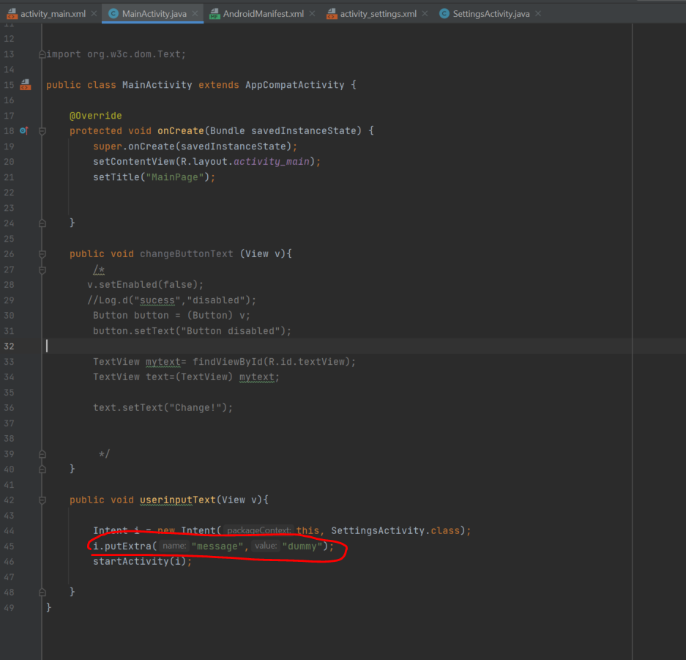
Pass information from pageA to pageB
Parent class (MainActivity.java)

Slide 22
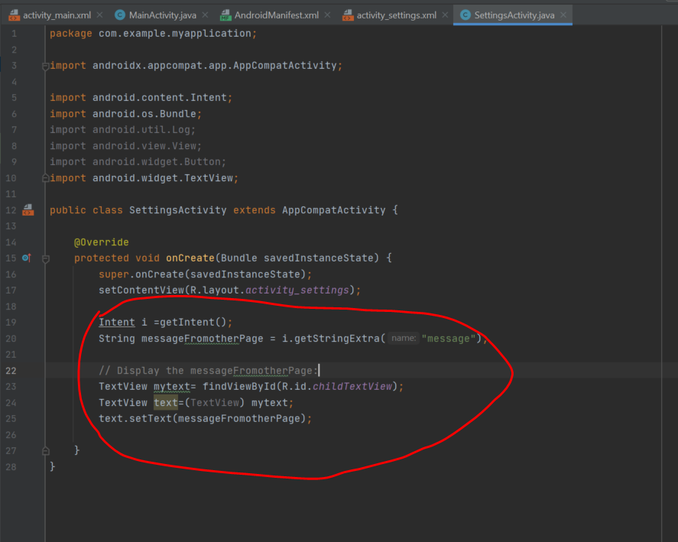
Child (settingactivity.java)

Slide 23
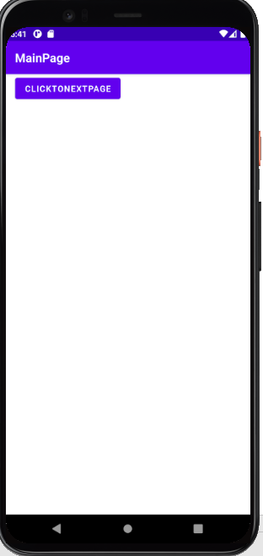
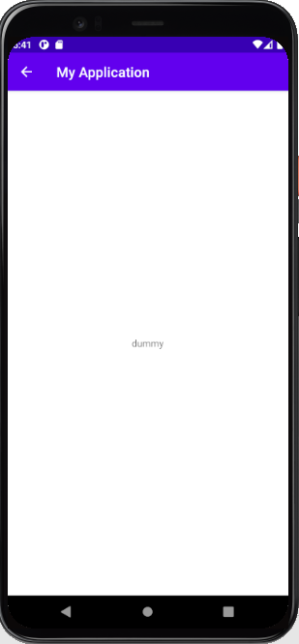
Result

Slide 24
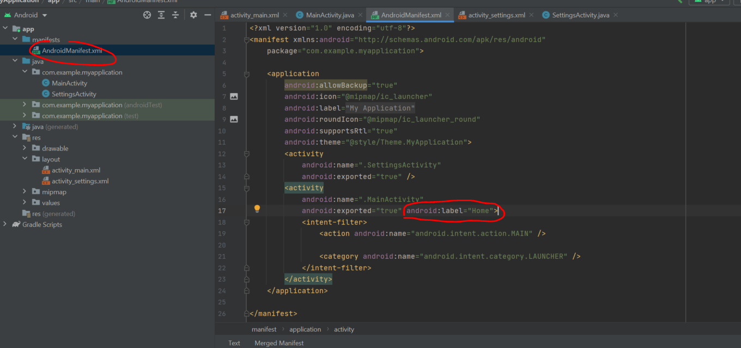
How to change app name

Slide 25
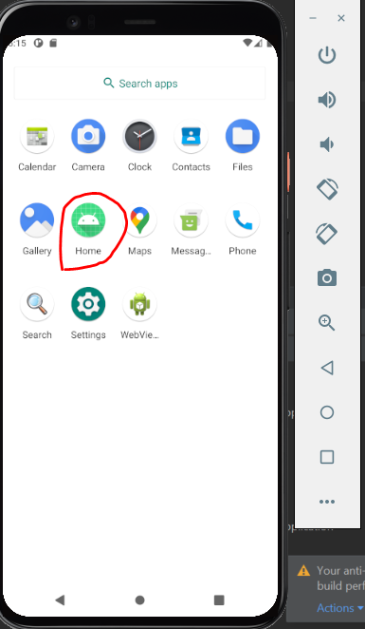
Results

Slide 26
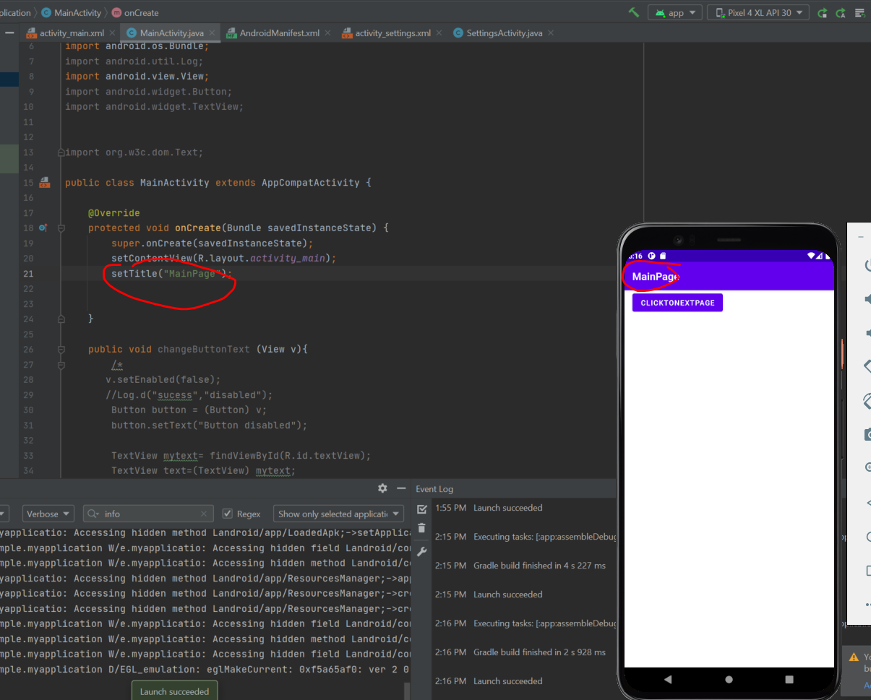
How to change individual page name

